Slide 1
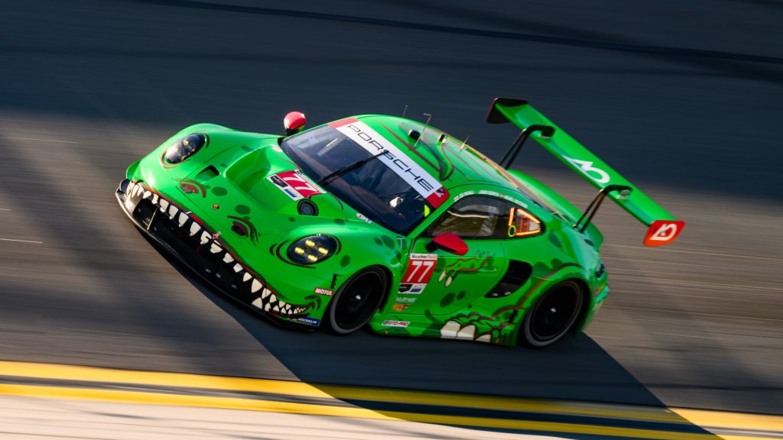
RC Car Project
2 P’s in a Pod, Jeremy Page and Kaleb Parsons.

Slide 2
What We Have Accomplished So Far
Drawn circuit diagrams for how we intend to build our circuit.
Acquired all the parts for the project (car and controller).
Began coding our Raspberry Pi.
Testing our code along the way.
Painting our car.

Slide 3
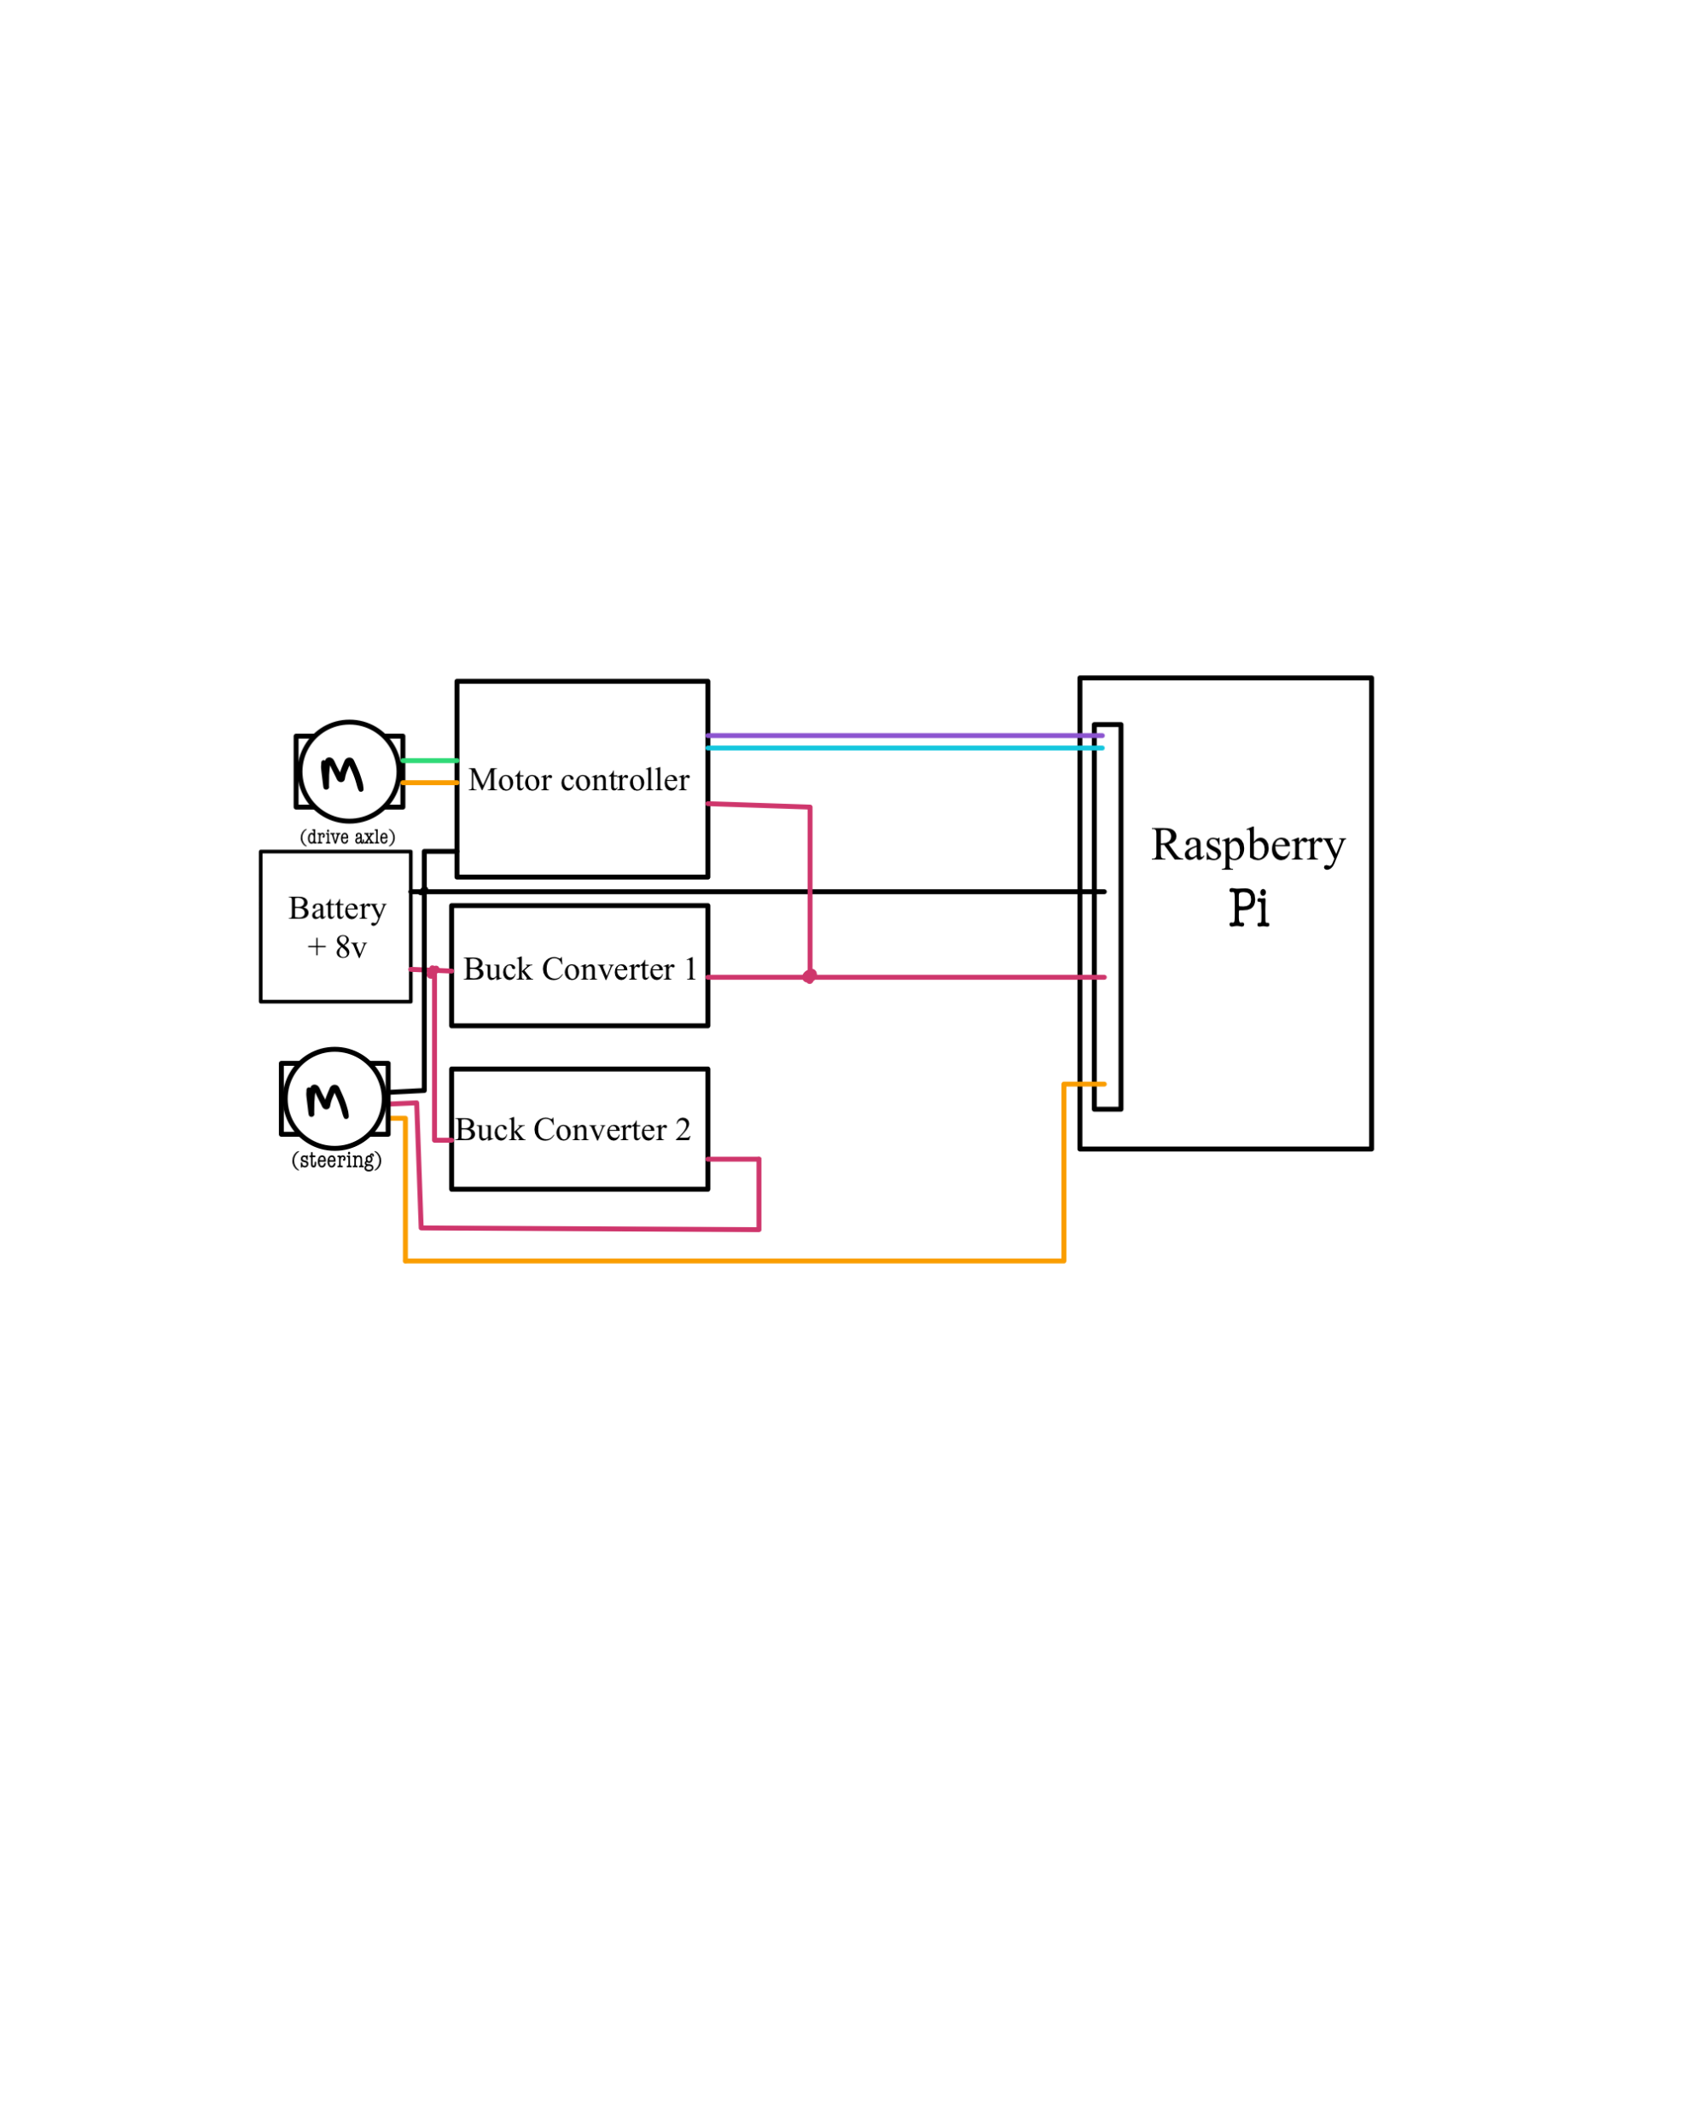
Circuit Digram
To the left is our circuit diagram for our car.
This diagram excludes the circuitry of the car and just shows how we plan on connecting our raspberry pi to our motors.
Future changes may need to be made.

Slide 4
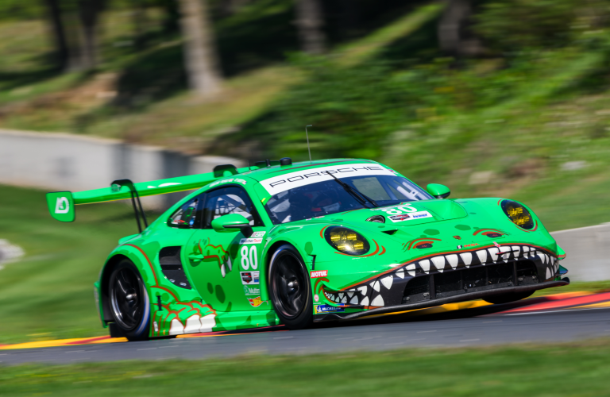
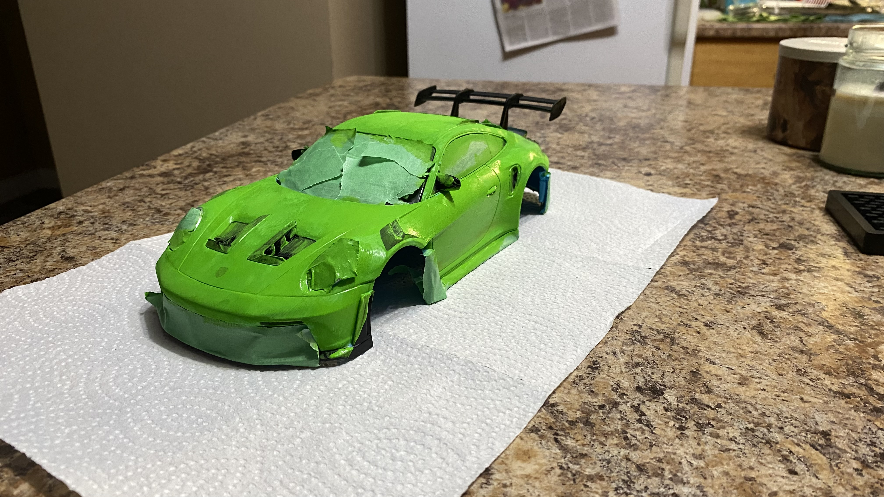
Car Design
The base coats have been added to the shell of our car.
The inspiration for our project is pictured above. The AO Racing Rexy Porsche which current races in IMSA.
This is a Porsche 911 GT3 R (992) which we are trying to model.
It is painted like a dinosaur (Hell Yeah)

Slide 5
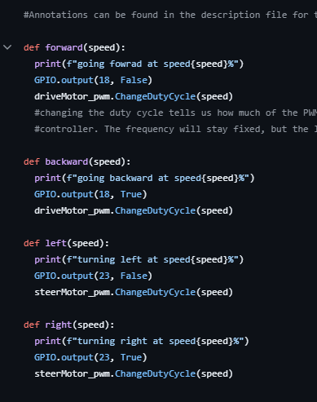
Coding
So far, coding our PI has been relatively ok.
There have been some difficulty in understanding what needs to be done.
Research into the API has been tedious (I AM GOING INSANE BOBBY ☺).
So far, we have defined the movement functions and written test code.
PWM (Pulse Width Modulation) and BCM numbering have been key focus points of our code.

Slide 6
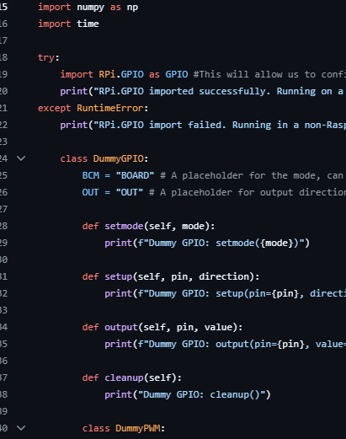
Coding Cont’d
One of the issue we ran into is with the GPIO function.
Collab does not allow us to compile without a ‘Dummy’ GPIO.
GPIO allows us to program specific pins on the PI to complete certain functions.
This allows us to compile our code and test along the way, without the need to connect to our PI.

Slide 7
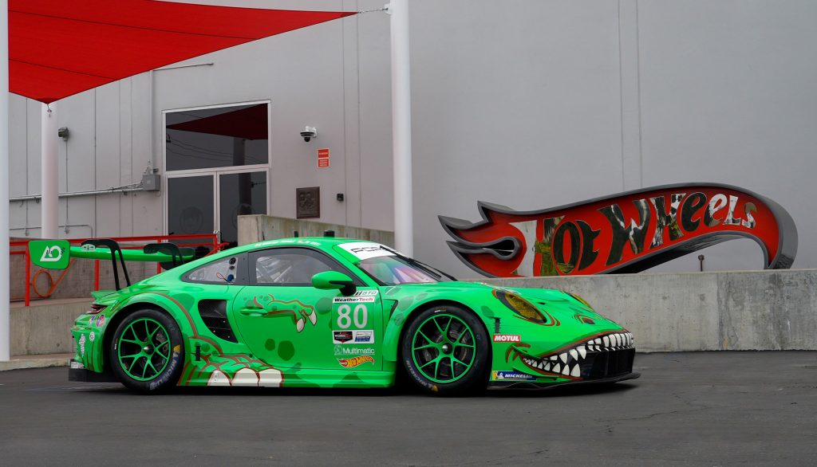
Coding cont’d
We have the basic functions our car needs to operate.
We still need to write code to be able to connect our controller to our PI.
We also still need to write code to convert our controller inputs into python and allow them to change our movement functions.

Slide 8
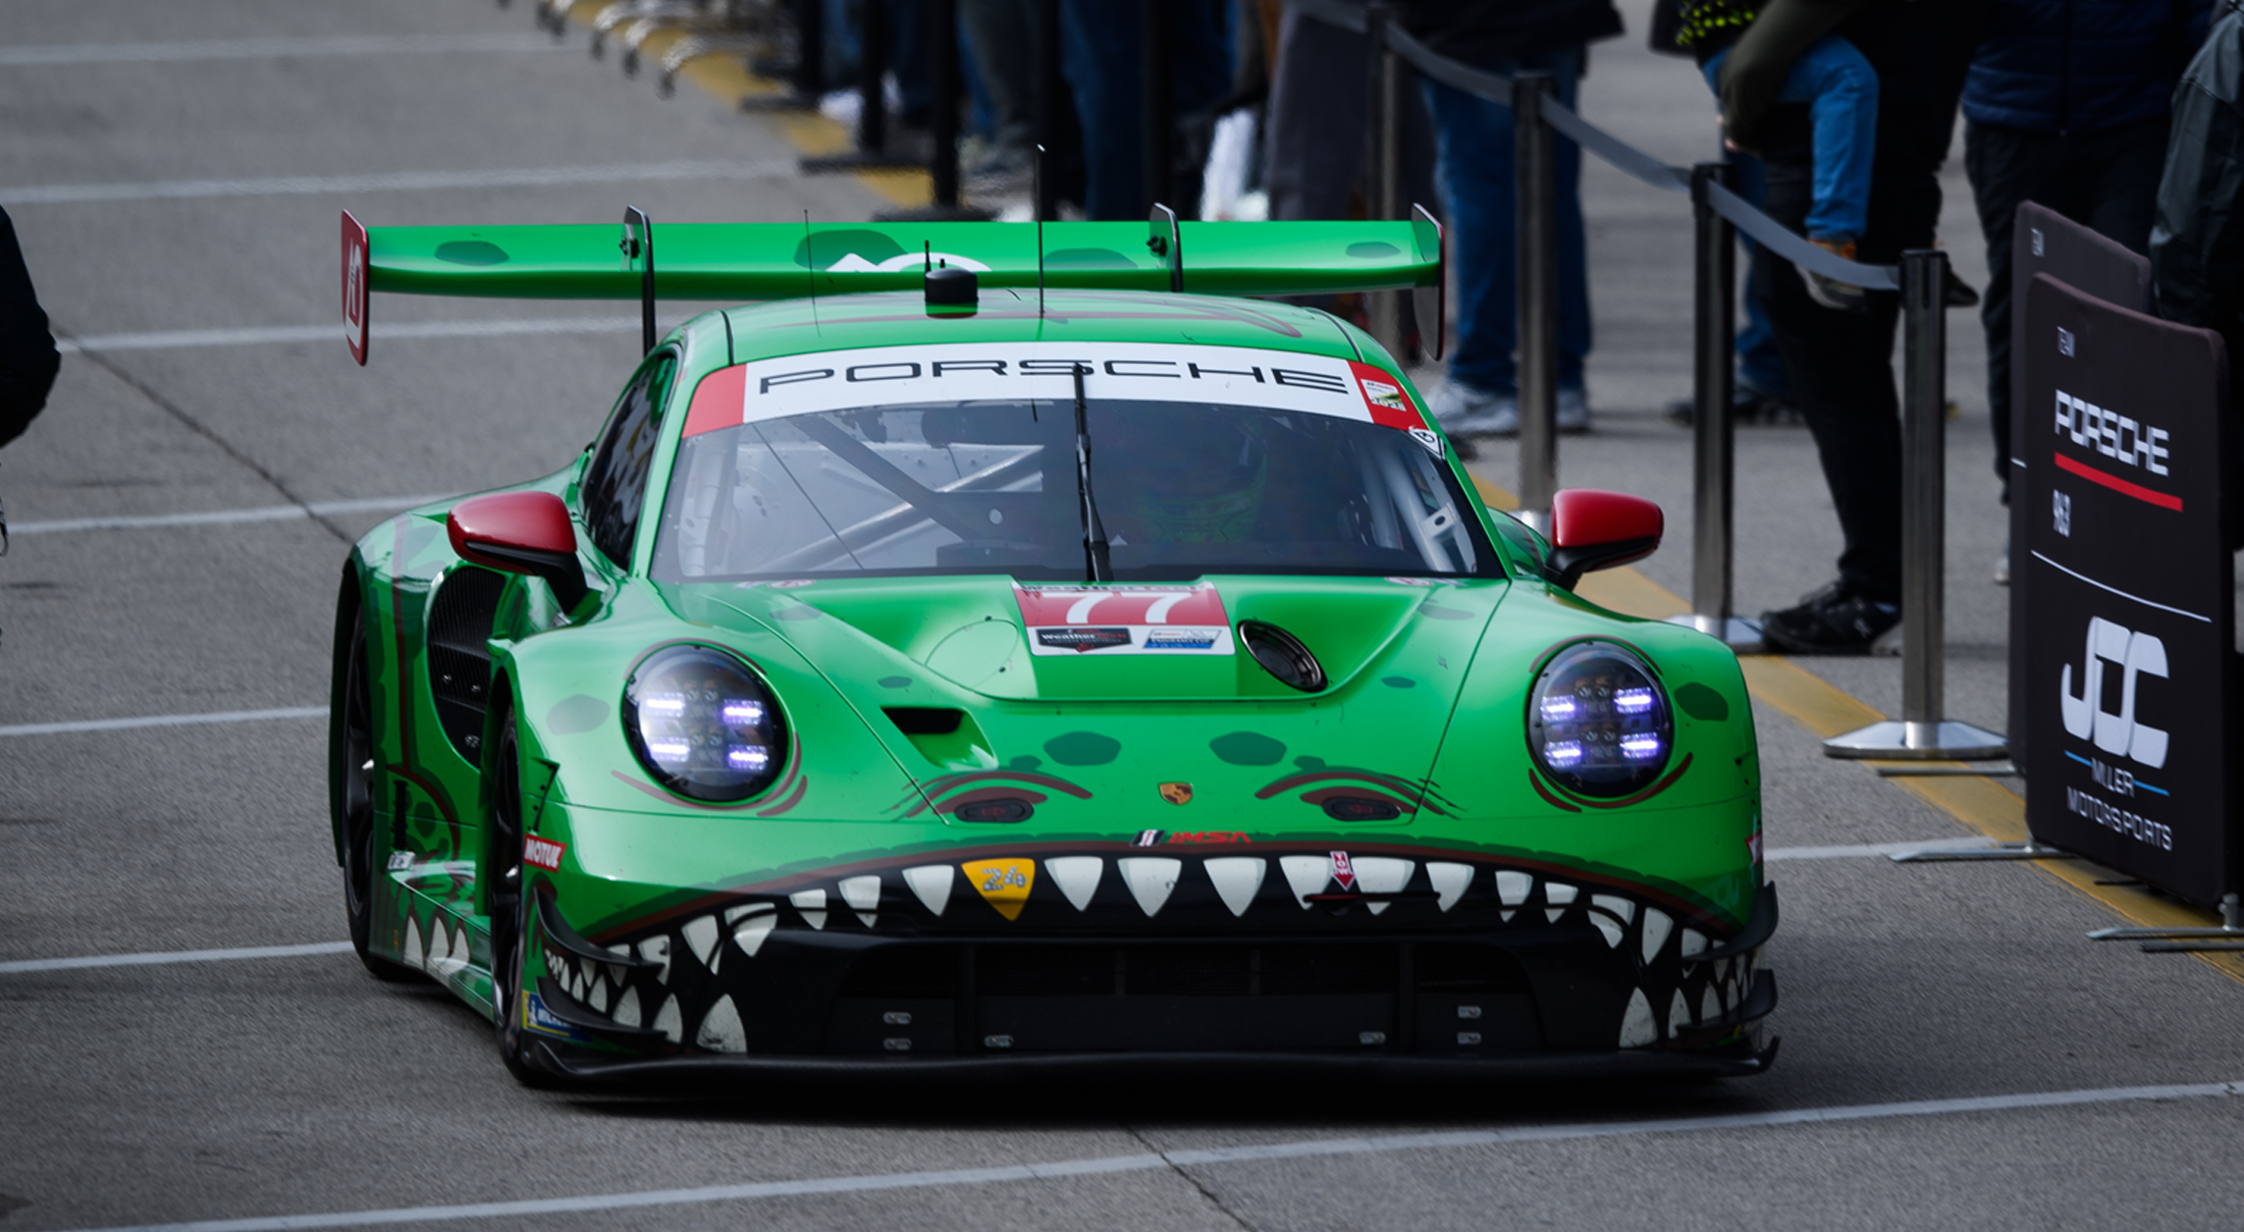
What Remains
Wiring of our car.
Wrapping up the coding of our car.
Testing and debugging.
Finish painting.
Reassembly.

Slide 9
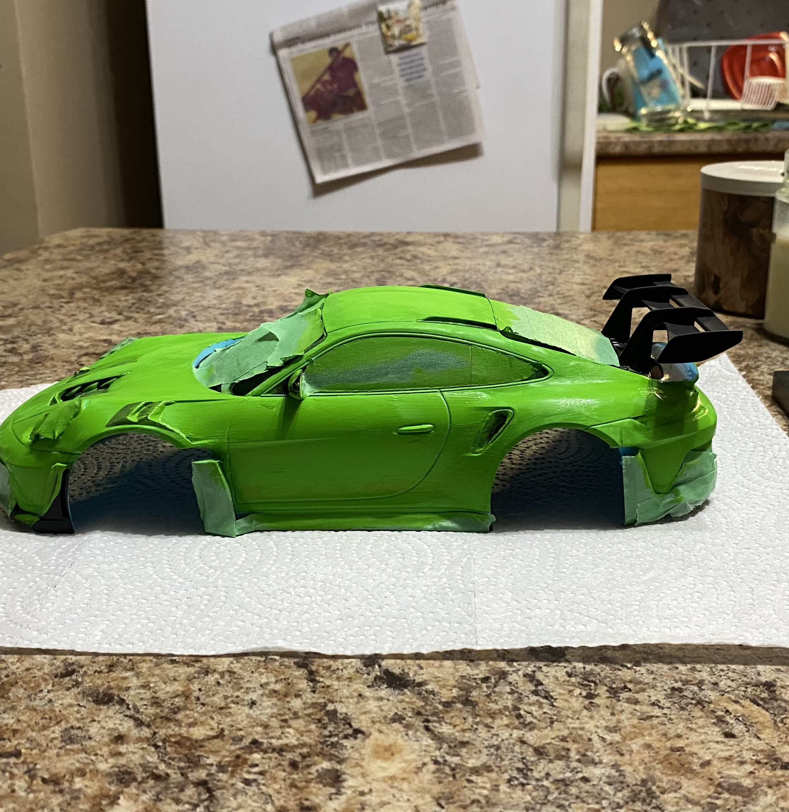
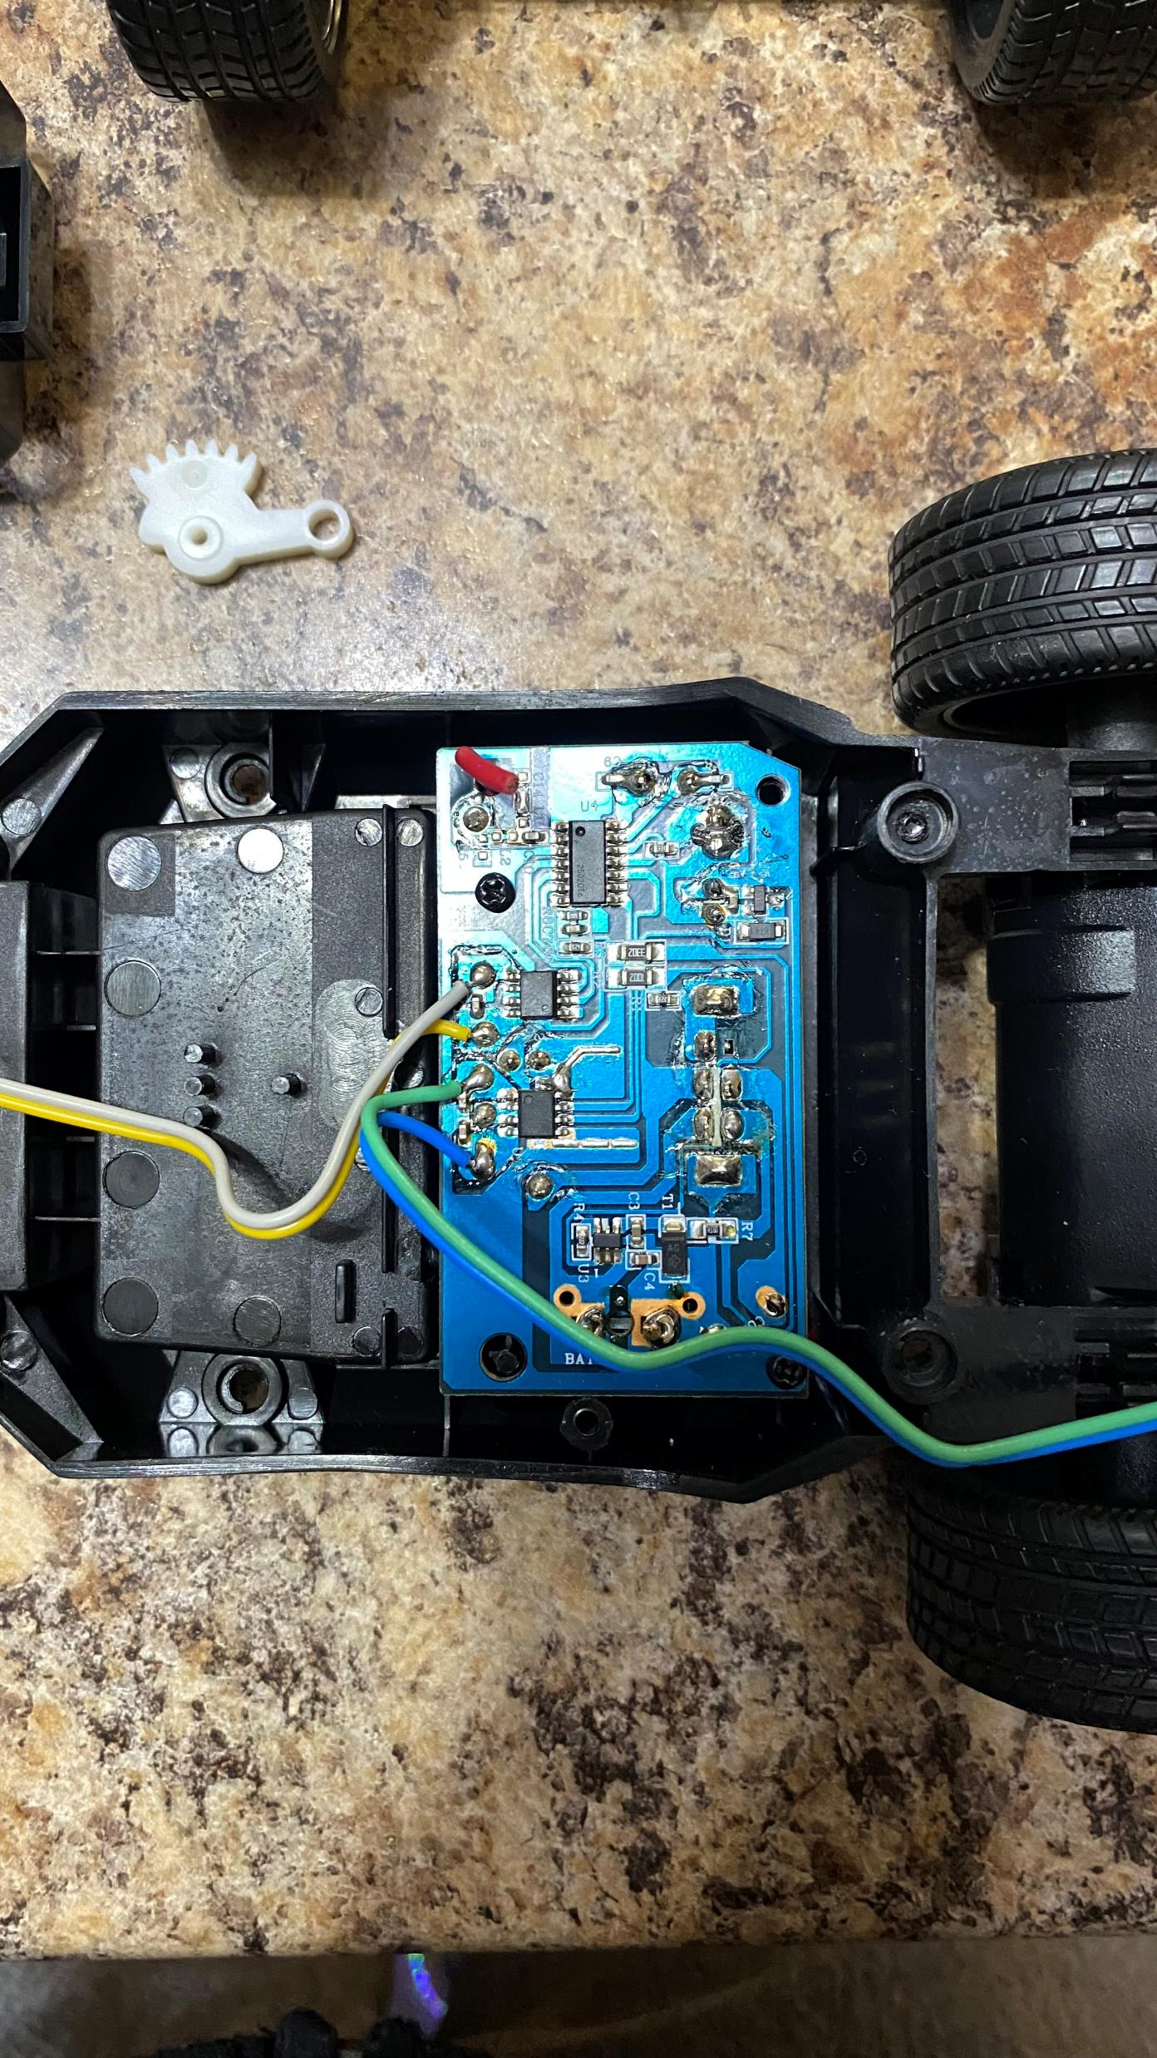
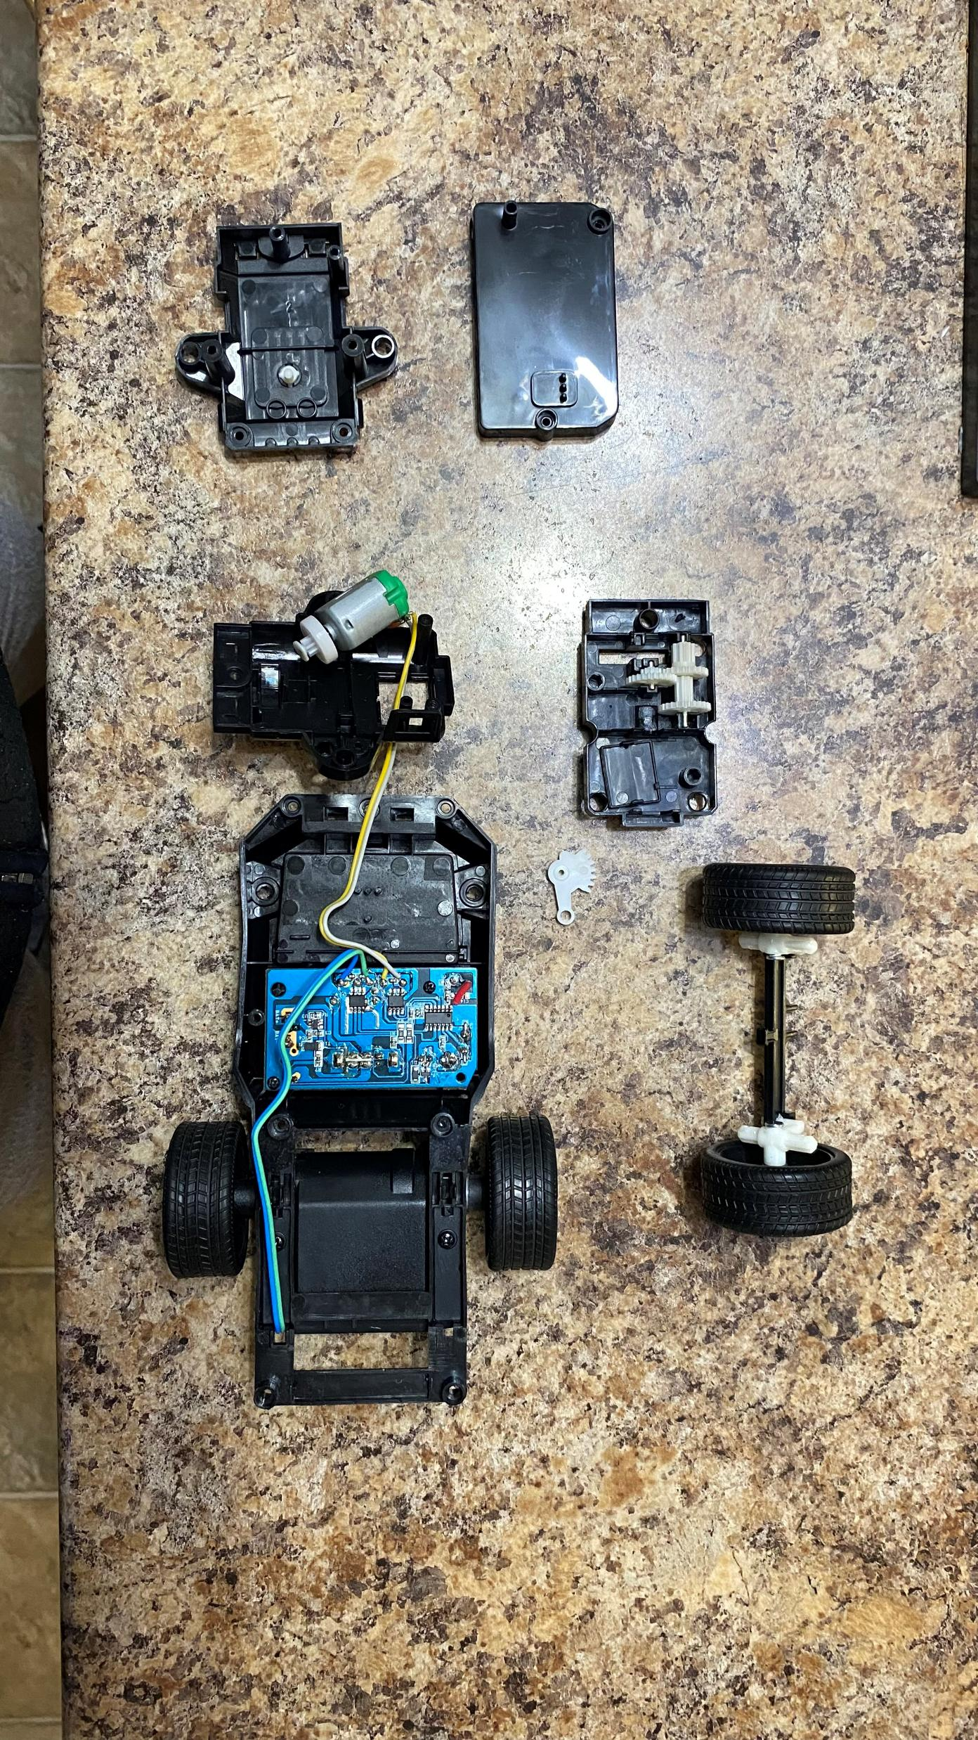
Images Along the Way

Slide 10
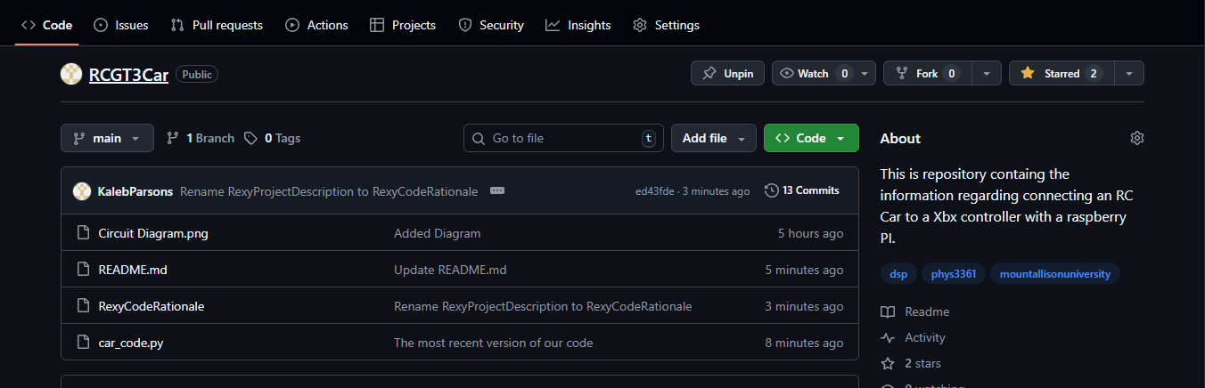
GitHub Repository
If you wish to follow along with our journey, here is the link to our GitHub repository:
https://github.com/KalebParsons/RCGT3Car
All updates to our project will be posted th
ere.

